Slide 1

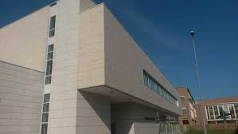
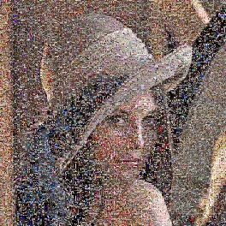
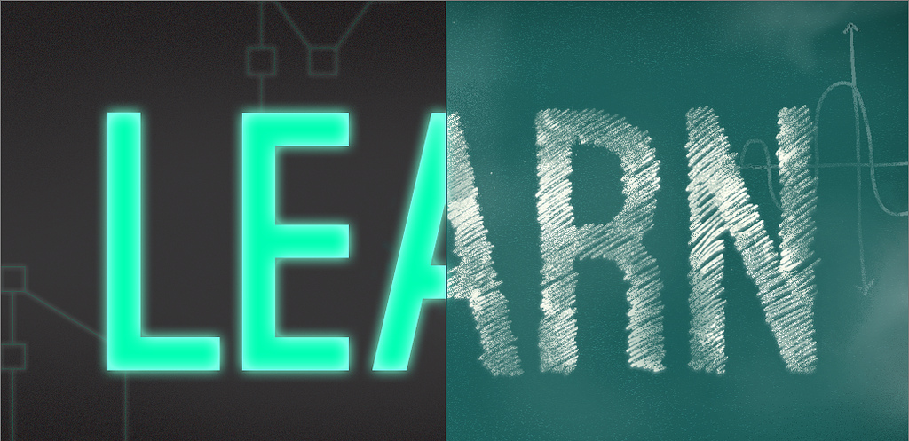
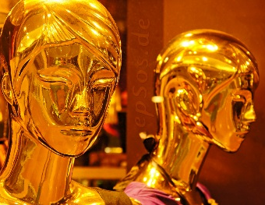
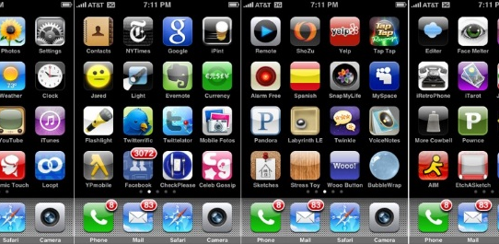
Pattern Recognition and Machine Learning Ensemble Methods Simone Calderara
Dipartimento di Ingegneria «Enzo Ferrari»,
Università di Modena e Reggio Emilia

Slide 2
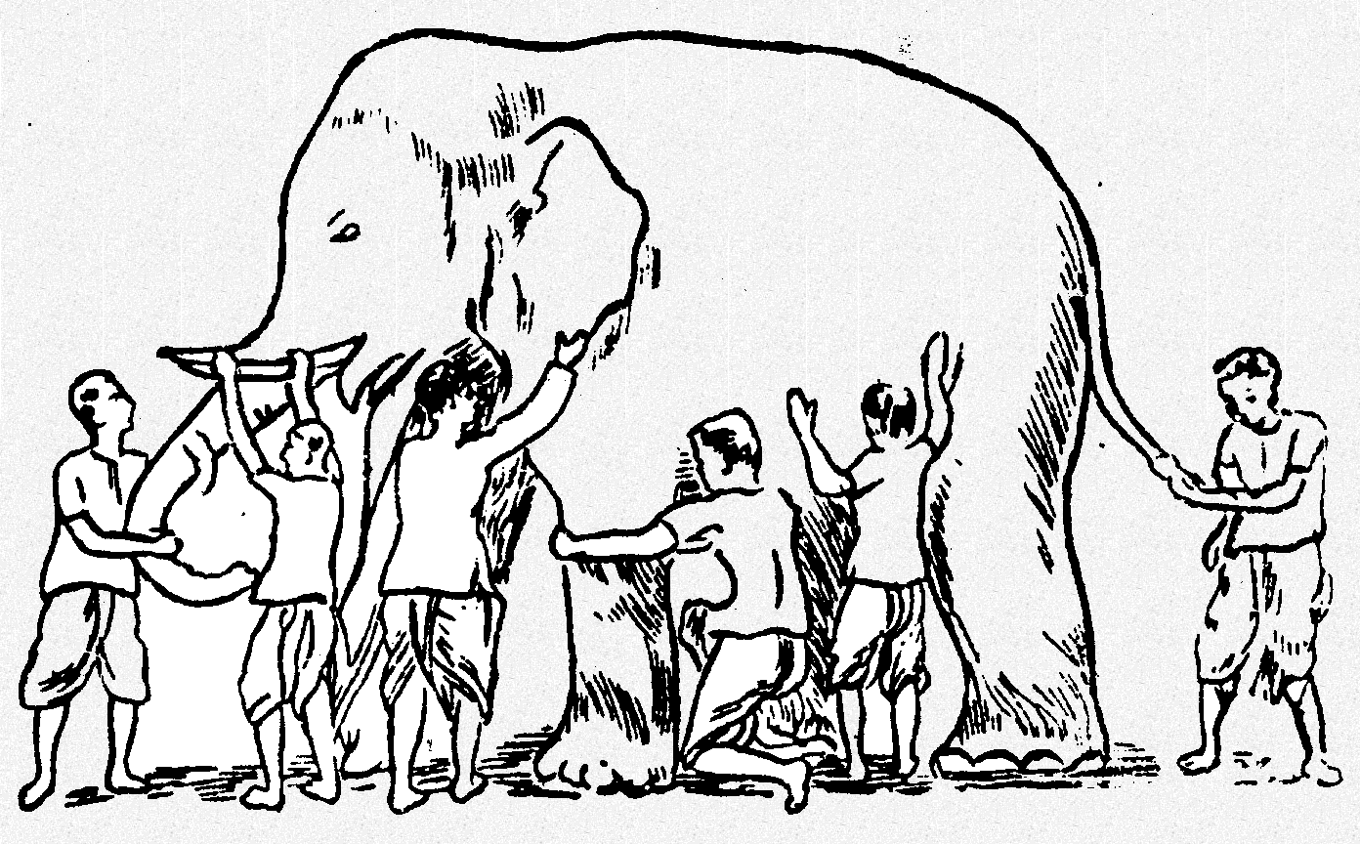
Ensemble Methods
Basic idea is to learn a set of classifiers (experts) and to allow them to vote.
Advantage: improvement in predictive accuracy.
Disadvantage: it is difficult to understand an ensemble of classifiers.
Model 1
Model 3
Model 6
Model 5
Model 2
Model 4

Slide 3
Method for ensembles building
One way to force a learning algorithm to construct multiple hypotheses
run the algorithm several times and provide it with somewhat different data This idea is used in the following methods:
Majority Voting
Bagging
Randomness Injection
Feature-Selection Ensembles:
Boosting

Slide 4
Majority Voting
Build Multiple classifier and take the majority of responses
Original
D
Training data
Step 1:
Build Multiple
C
C
C
C
Classifiers
1
2
t -1
t
Step 2:
Combine
C
*
Classifiers

Slide 5
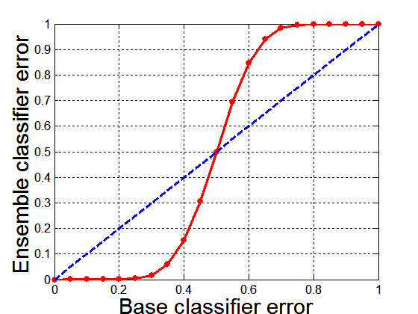
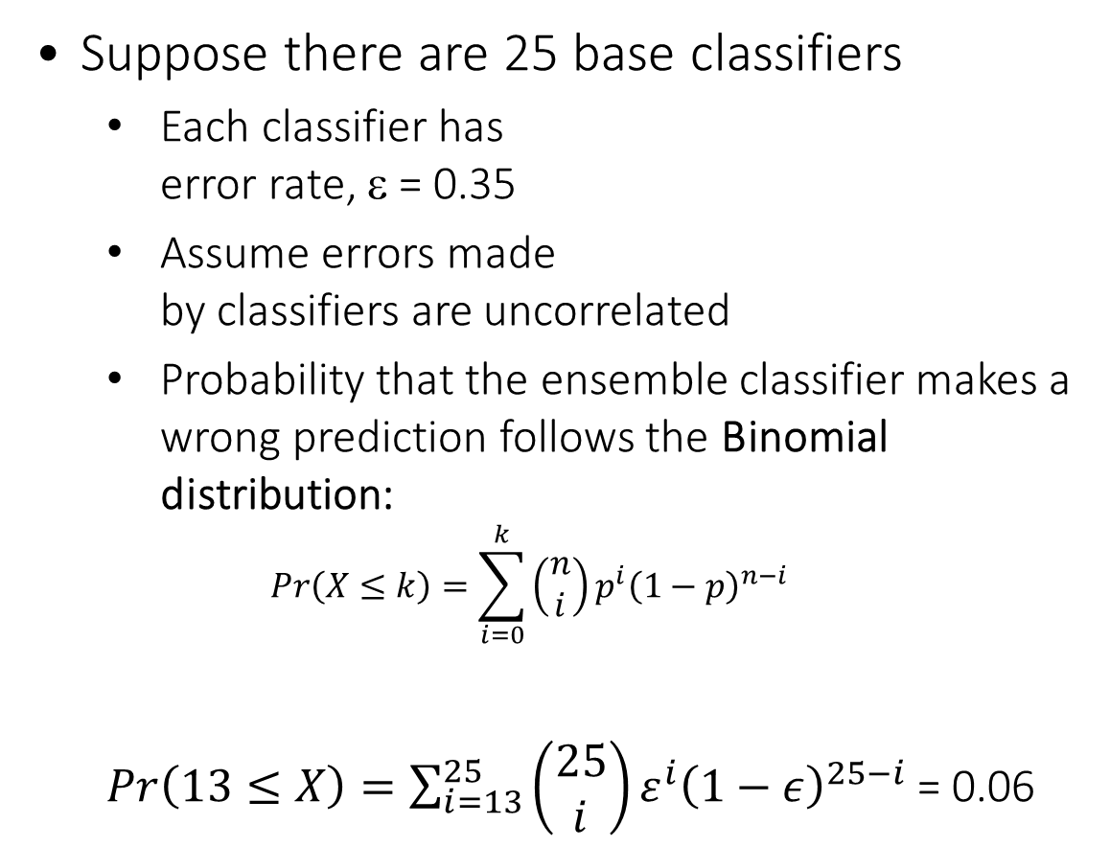
Why does majority work
Suppose there are 25 base classifiers
Each classifier has error rate, ε = 0.35
Assume errors made by classifiers are uncorrelated
Probability that the ensemble classifier makes a wrong prediction follows the Binomial distribution:
$$Pr\left(X≤k\right)=\sum_{i=0}^{k}{\left(\begin{matrix}n \\ i\end{matrix}\right)p^{i}{\left(1−p\right)}^{n−i}}$$
$Pr\left(13≤X\right)=\sum_{i=13}^{25}{\left(\begin{matrix}25 \\ i\end{matrix}\right)ε^{i}{\left(1−ε\right)}^{25−i}}$ = 0.06

Slide 6
Bagging
Introduced by Breiman (1996) “Bagging” stands for “bootstrap aggregating”.
Employs simplest way of combining predictions that belong to the same type.
Combining can be realized with voting or averaging
Each model receives equal weight
Idealized” version of bagging:
Sample several training sets of size n (instead of just having one training set of size n)
Build a classifier for each training set
Combine the classifier’s predictions
This improves performance in almost all cases

Slide 7
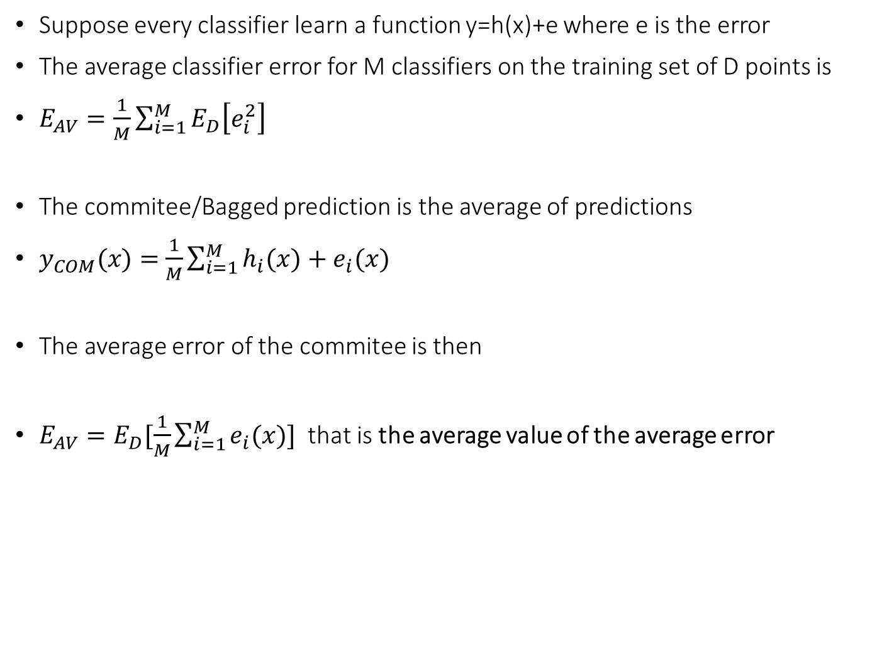
Why does it works
Suppose every classifier learn a function y=h(x)+e where e is the error
The average classifier error for M classifiers on the training set of D points is
$E_{AV}=\frac{1}{M}{\sum_{i=1}^{M}{E_{D}\left[e_{i}^{2}\right]}}^{}$
The commitee/Bagged prediction is the average of predictions
$y_{COM}(x)=$ $\frac{1}{M}{\sum_{i=1}^{M}{h_{i}(x)+e_{i}(x)}}^{}$
The average error of the commitee is then
$E_{AV}=E_{D}[\frac{1}{M}\sum_{i=1}^{M}{e_{i}(x)] }$that is the average value of the average error

Slide 8
Main types of Ensemble methods
Combine multiple models together
Committees - Bagging
Classification: Make classification by voting over a collection of classifiers
Boosting - Adaboost
Train multiple models in sequence
Decision trees
Different models are responsible for making predictions in different regions of input space

Slide 9
Bagging = Bootstrap aggregating (1994)
We only have 1 single dataset
Create new dataset using “bootstrap” procedure
Randomly resample
Learn model for each new dataset
Average different models

Slide 10
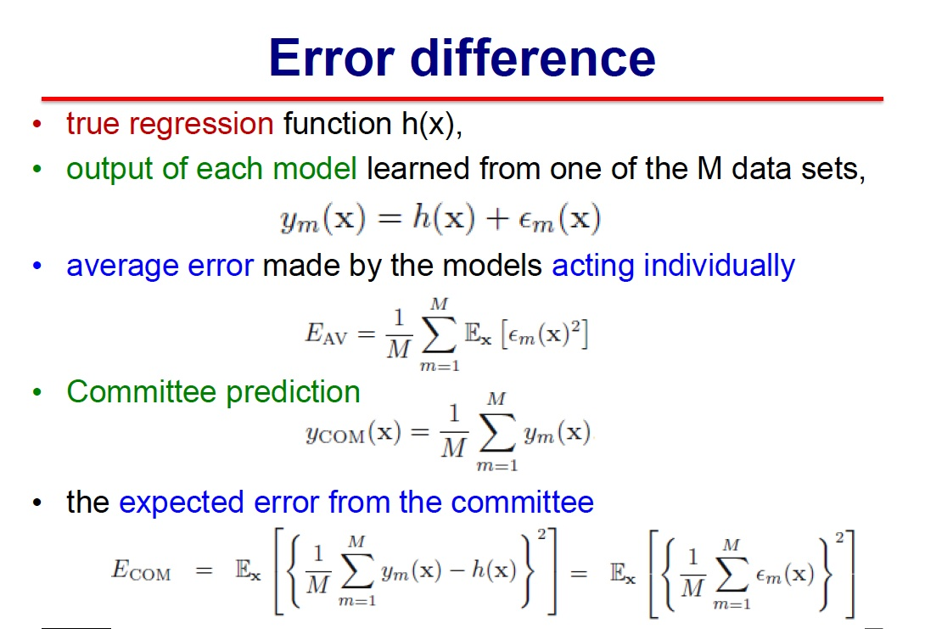
“bootstrap”

Slide 11
“bootstrap”

Slide 12
“bootstrap”

Slide 13
“bootstrap”

Slide 14
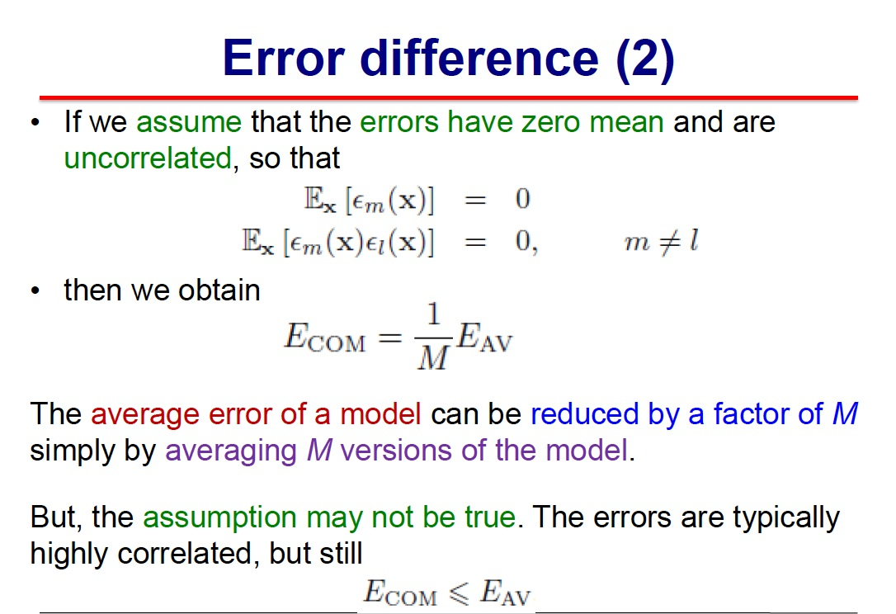

Slide 16
“bagging”: reduces variance
and helps to avoid overfitting
use “boosting” technique
to achieve more significant improvement

Slide 17
Main types of Ensemble methods
Combine multiple models together
Committees - Bagging
Classification: Make classification by voting over a collection of classifiers
Boosting - Adaboost
Train multiple models in sequence
Decision trees
Different models are responsible for making predictions in different regions of input space

Slide 18
Main types of Ensemble methods
Combine multiple models together
Committees - Bagging
Classification: Make classification by voting over a collection of classifiers
Boosting - Adaboost
Train multiple models in sequence
Decision trees
Different models are responsible for making predictions in different regions of input space

Slide 19
Boosting
Boosting is considered to be one of the most significant developments in machine learning
Finding many weak rules of thumb is easier than finding a single, highly prediction rule
Key in combining the weak learners (just marginally better than random)
Train models successfully to correct the previous models’ errors

Slide 20
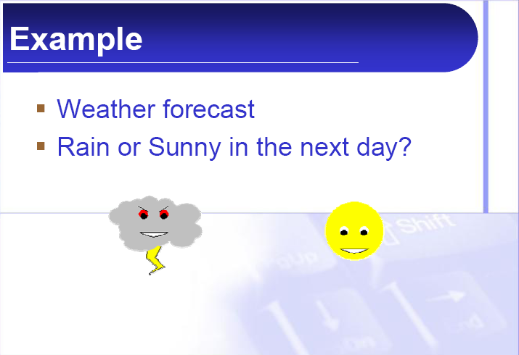
Boosting - idea

Slide 21
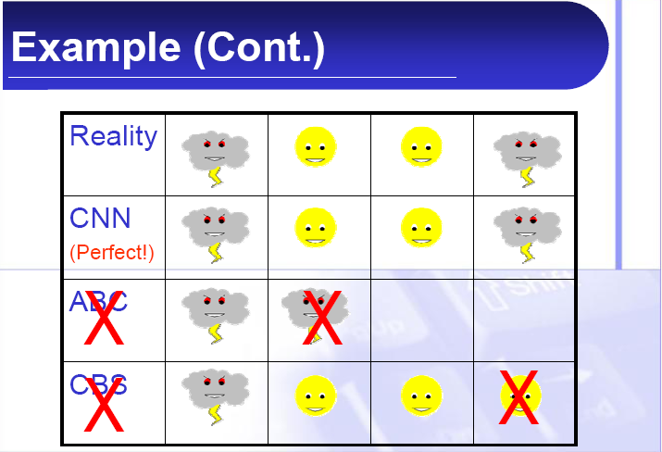
Boosting

Slide 22
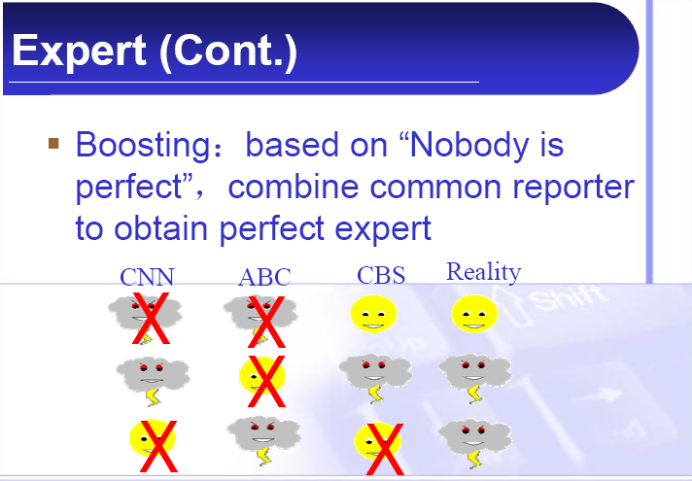
Boosting

Slide 23
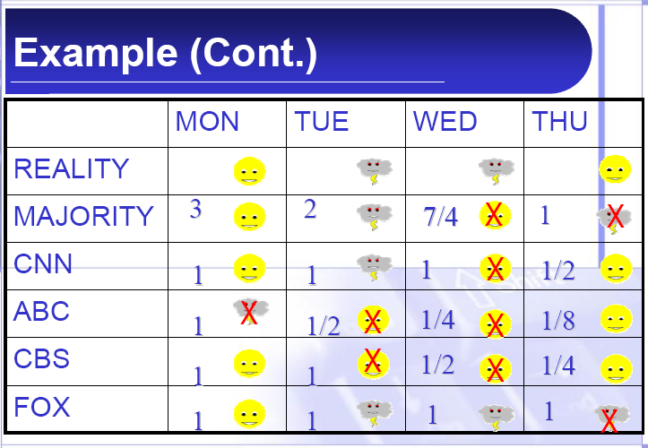
Boosting

Slide 24
Boosting

Slide 25
Boosting

Slide 26
Boosting

Slide 27
Boosting
Boosting history
Kearns & Valiant (1989)
Proved the astonishing fact that weak learners, each performing only slightly better than random, can be combined to form an arbitrarily good ensemble hypothesis
Schapire (1990)
First to provide a provable polynomial time Boosting algorithm
Schapire, e.a. (1993)
First application of Boosting idea to a real world OCR task
Freund and Schapire (1994-1996)
AdaBoost algorithm

Slide 28
Boosting
Idea
Simple hypothesis are not perfect!
Hypotheses combination => increased accuracy
Problems
How to generate different hypotheses?
How to combine them, in a sequential way?

Slide 29
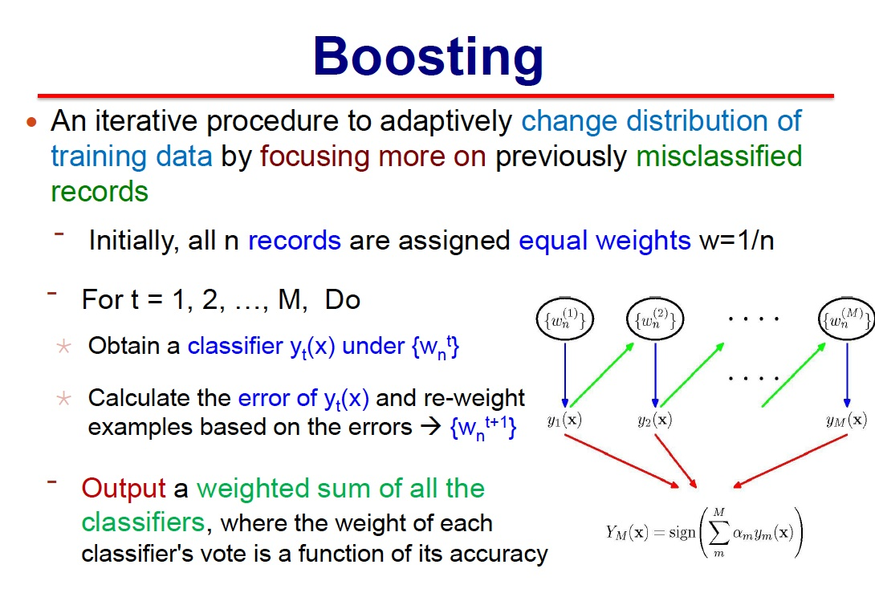

Slide 30
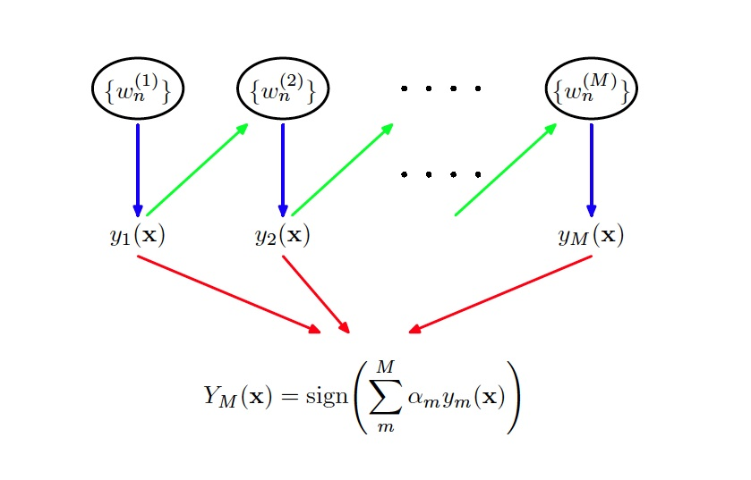
Boosting

Slide 32
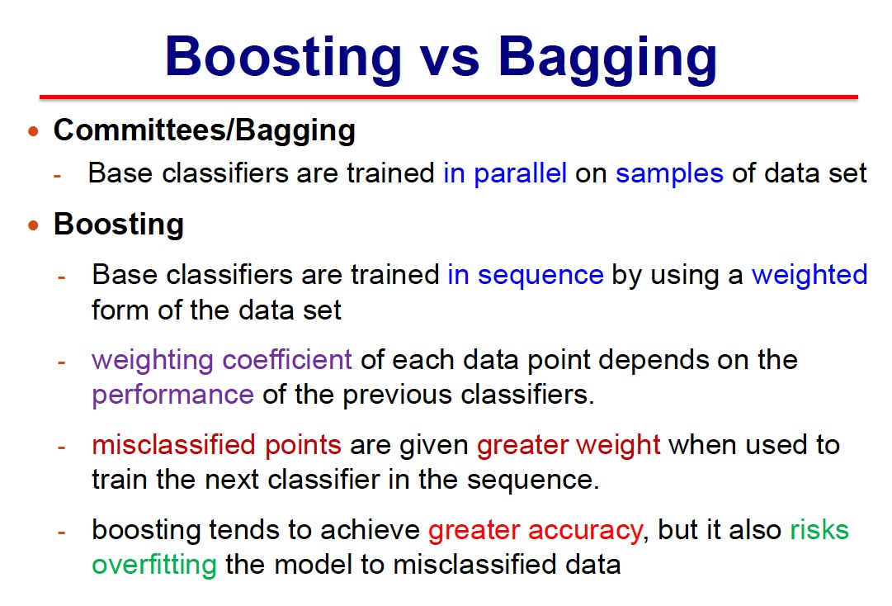

Slide 34
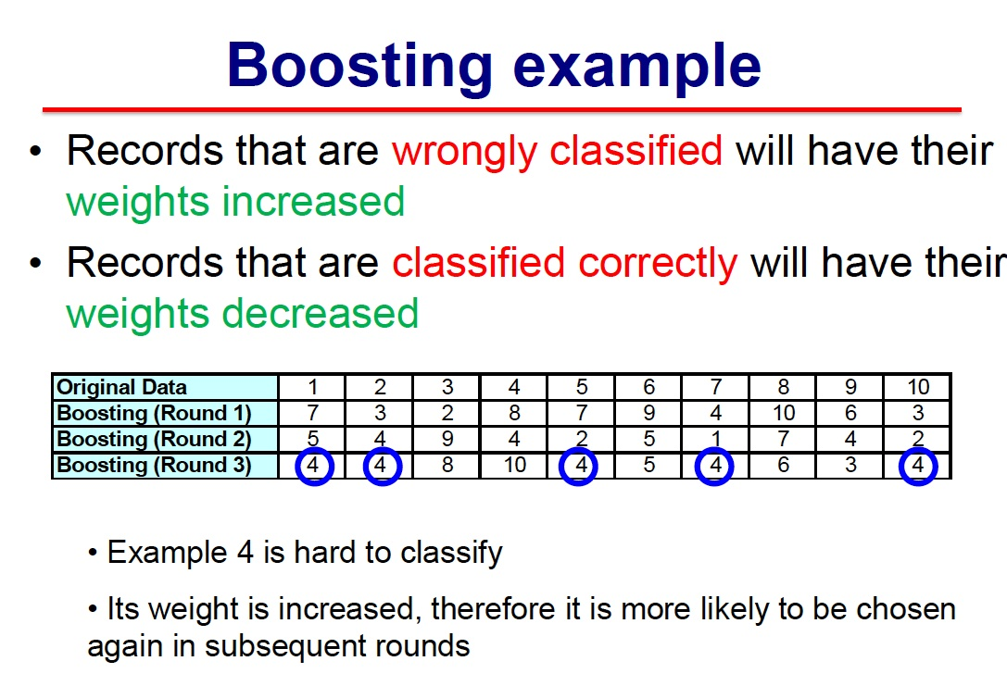

Slide 35
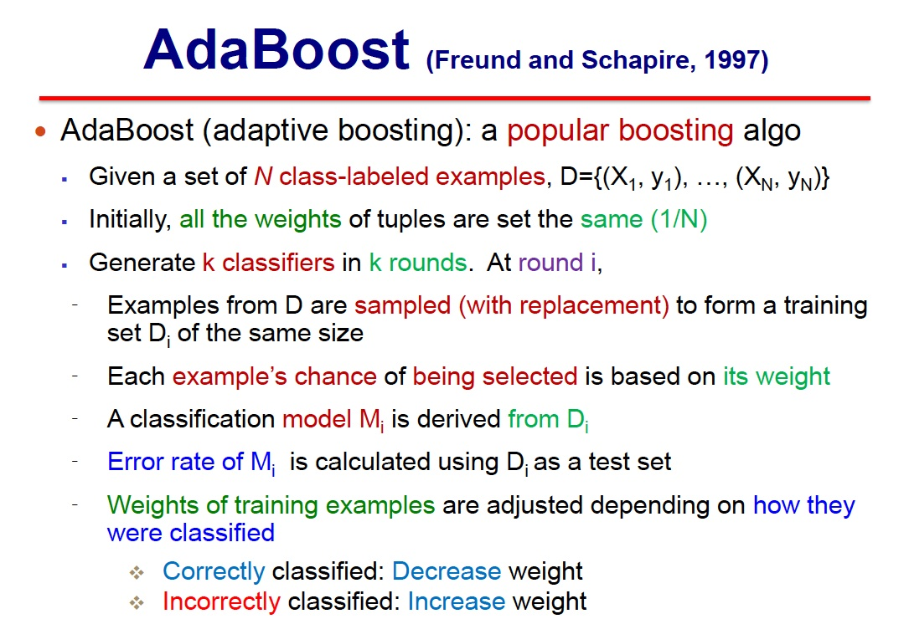

Slide 36
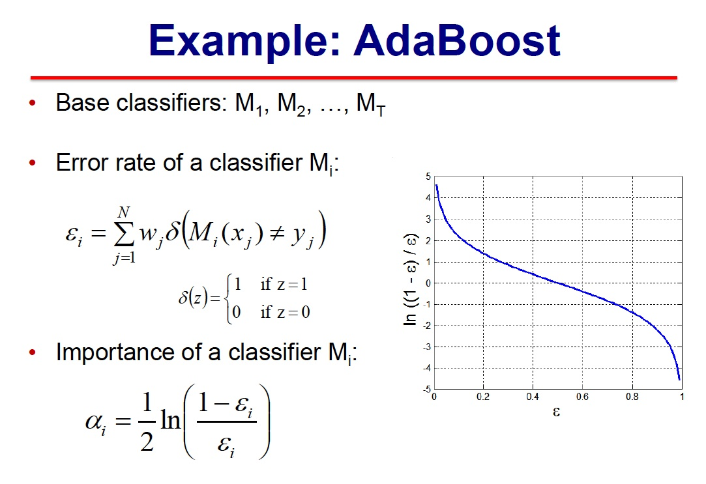

Slide 37
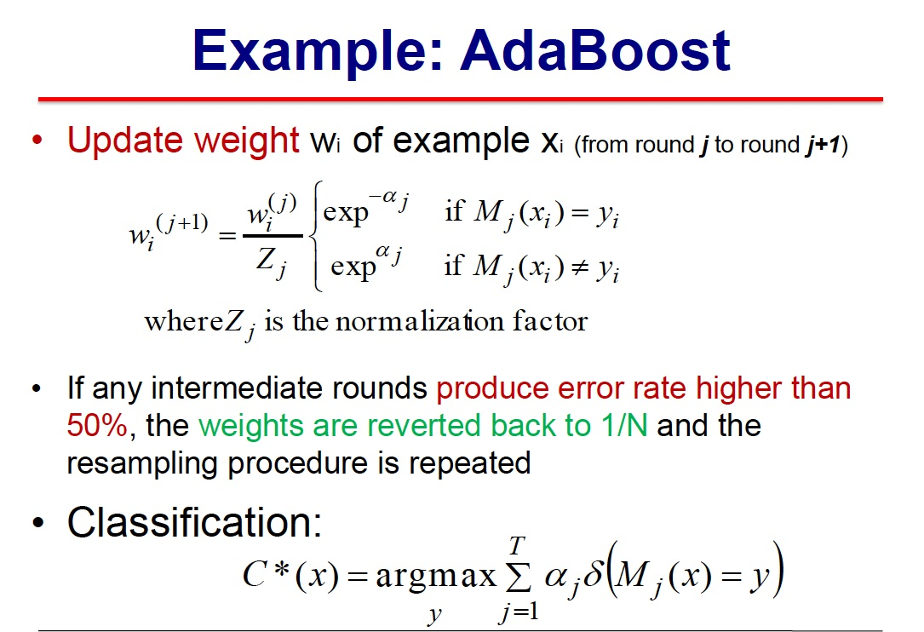

Slide 38
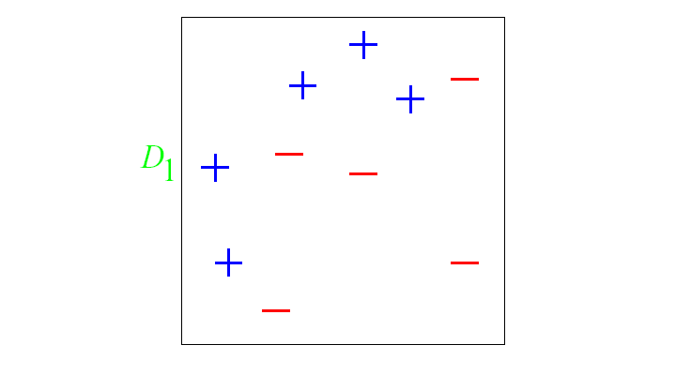
AdaBoost - Example
Round 0: Equal Weights to all training samples
Taken from “A Tutorial on Boosting” by Yoav Freund and Rob Schapire

Slide 39
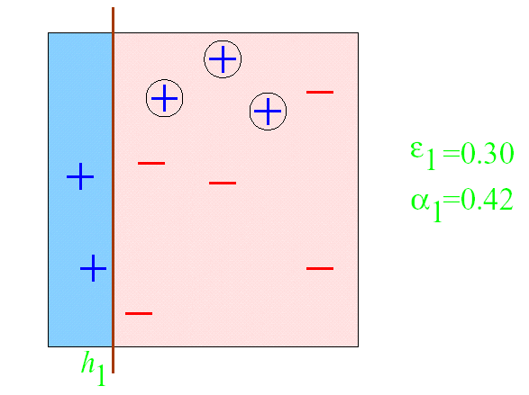
AdaBoost - Example
ROUND 1

Slide 40
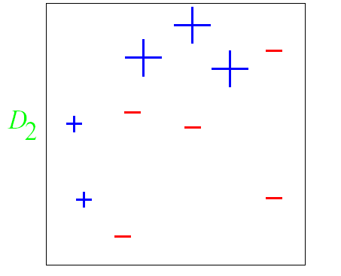
AdaBoost - Example
ROUND 1

Slide 41
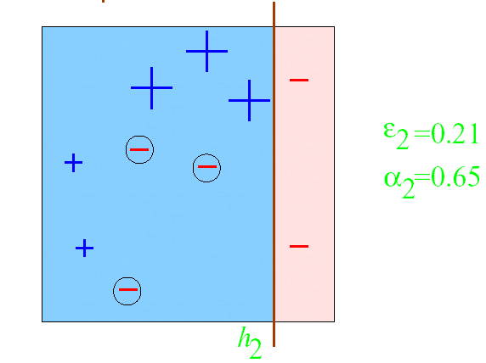
AdaBoost - Example
ROUND 2

Slide 42
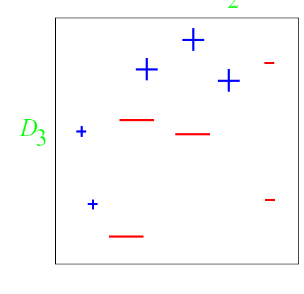
AdaBoost - Example
ROUND 2

Slide 43
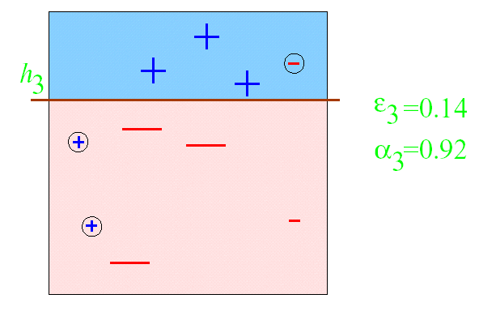
AdaBoost - Example
ROUND 3

Slide 44
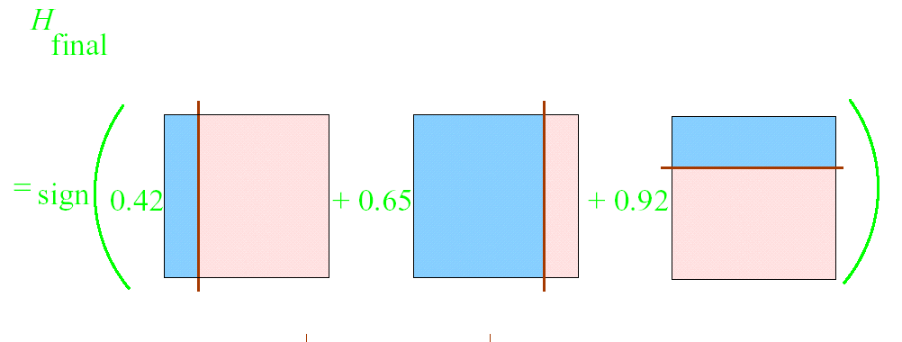
AdaBoost - Example

Slide 45
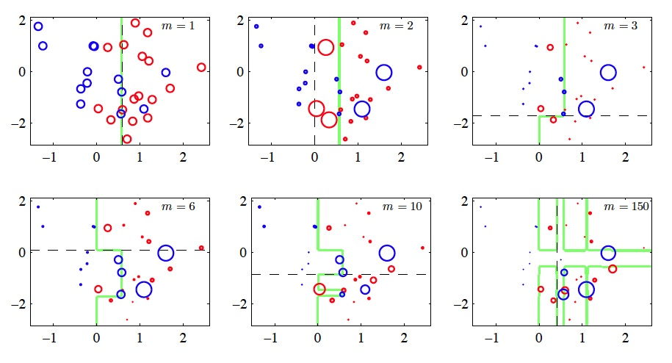
AdaBoost – Example 2
45

Slide 46
Strengths of AdaBoost
It has no parameters to tune (except for the number of rounds)
It is fast, simple and easy to program (??)
It comes with a set of theoretical guarantee (e.g., training error, test error)
Instead of trying to design a learning algorithm that is accurate over the entire space, we can focus on finding base learning algorithms that only need to be better than random.
It can identify outliners: i.e. examples that are either mislabeled or that are inherently ambiguous and hard to categorize.

Slide 47
Weakness of AdaBoost
The actual performance of boosting depends on the data and the base learner.
Boosting seems to be especially susceptible to noise.
When the number of outliners is very large, the emphasis placed on the hard examples can hurt the performance.
➔ “Gentle AdaBoost”, “BrownBoost”

